Slide 1

BOOK RECOMMENDER PROTOTYPE
FINAL PROJECT
Dàmaris Clariana
Ironhack DAFT May2021

Slide 2
INTRODUCTION
Personal interest
Recommender prototype
Own data collection

Slide 3
INTRODUCTION
Personal interest
Recommender prototype
Own data collection
CREATE SURVEY
Technical features (author, genre, pages, format…)
Characters (gender, age…)
Main topics
Reviews with selecting keywords
Descriptions → for text analysis

Slide 4
METHOD AND PROCESS

Slide 5
METHOD AND PROCESS
425 rows, 23 columns

Slide 6
METHOD AND PROCESS
425 rows, 23 columns
Cleaning & Explore
Text Analysis
Choose a model
Transform & OHE
Kmeans & clusters
Apply the model
Get clusters
Recommender

Slide 7
VISUALS

Slide 8

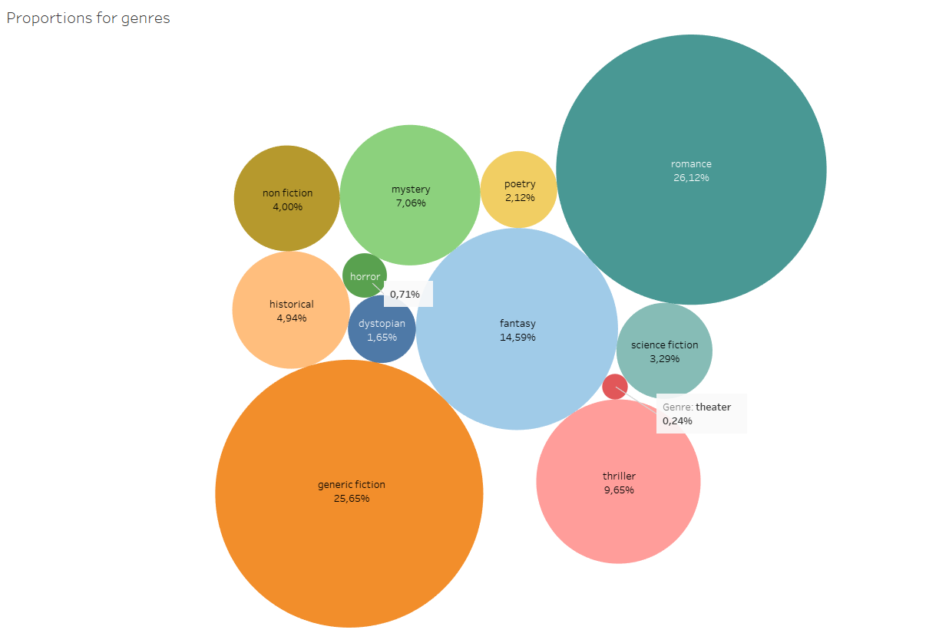
PROPORTIONS BY GENRES

Slide 9
PROPORTIONS BY GENRES

Slide 10
PROPORTIONS BY GENRES

Slide 11
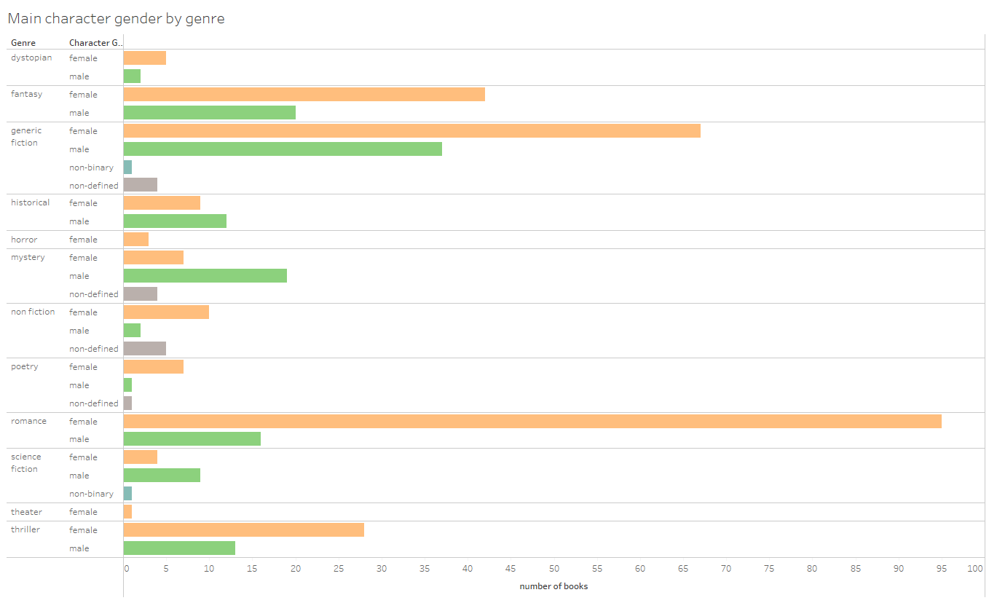
MAIN CHARACTER GENDER BY GENRE

Slide 12
MAIN CHARACTER GENDER BY GENRE

Slide 13
MAIN CHARACTER GENDER BY GENRE

Slide 14
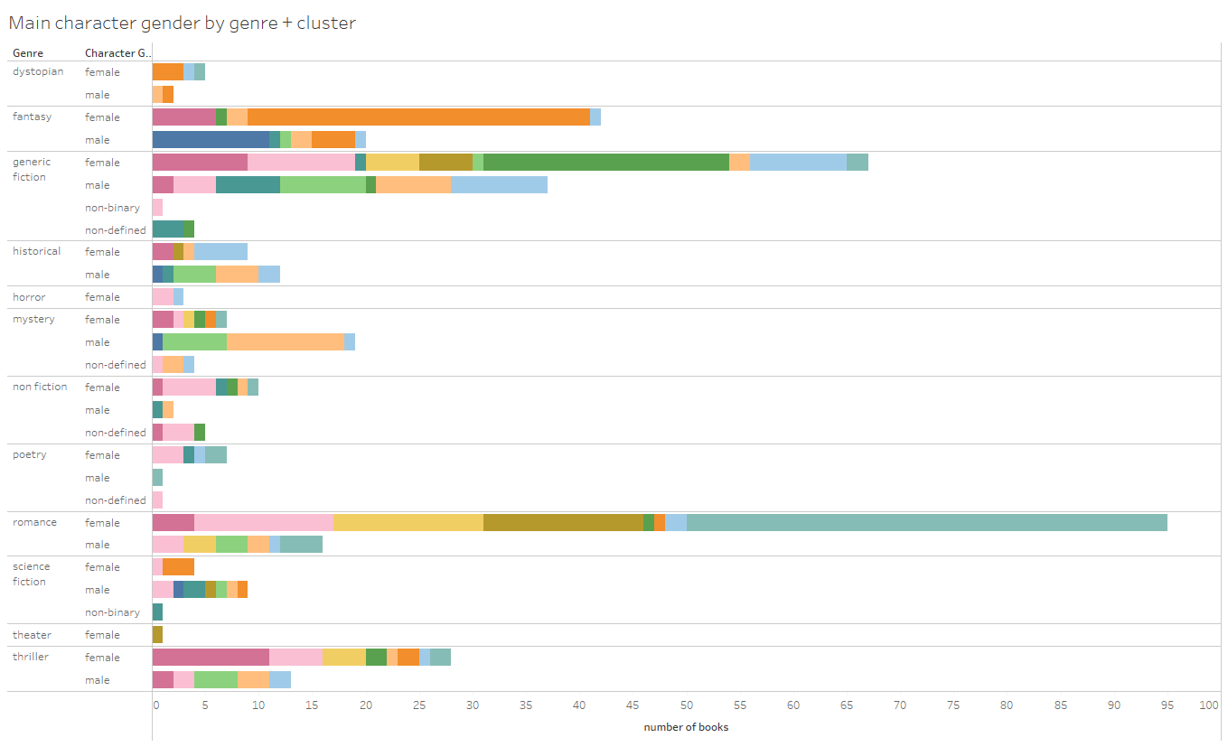
MAIN CHARACTER GENDER BY GENRE + CLUSTER
MAIN CHARACTER GENDER BY GENRE

Slide 15
MAIN CHARACTER GENDER BY GENRE + CLUSTER
MAIN CHARACTER GENDER BY GENRE
CLUSTER 0

Slide 16
MAIN CHARACTER GENDER BY GENRE + CLUSTER
MAIN CHARACTER GENDER BY GENRE
CLUSTER 9

Slide 17
MAIN CHARACTER GENDER BY GENRE + CLUSTER
MAIN CHARACTER GENDER BY GENRE
CLUSTER 2

Slide 18
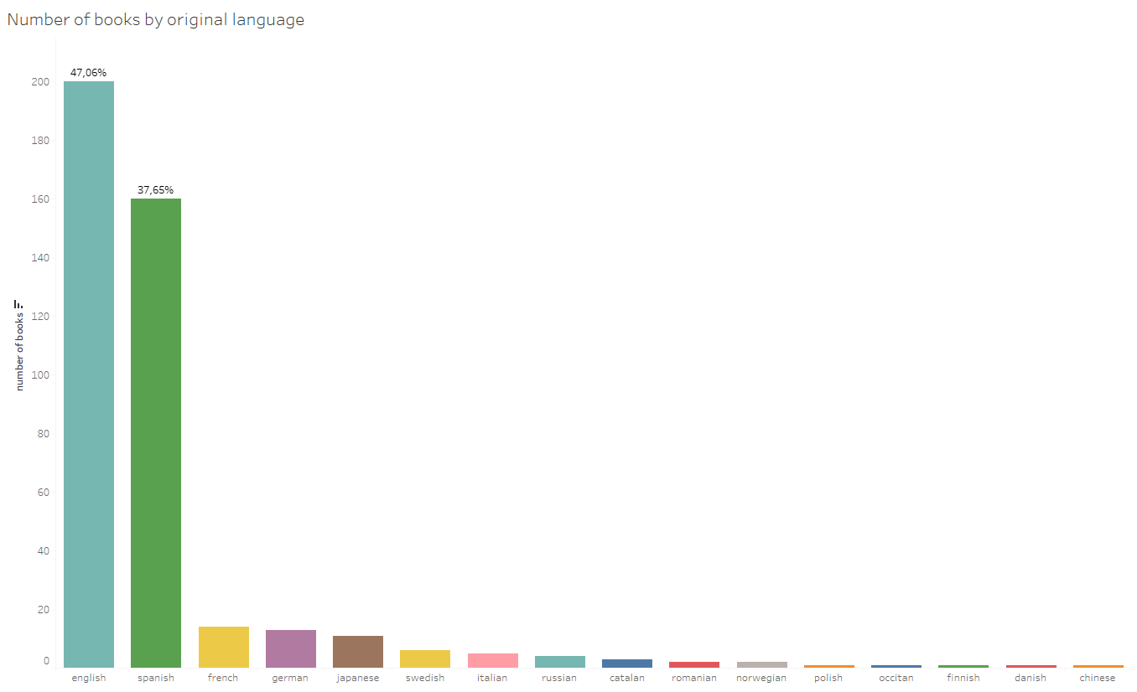
ORIGINAL LANGUAGE

Slide 19
ORIGINAL LANGUAGE

Slide 20
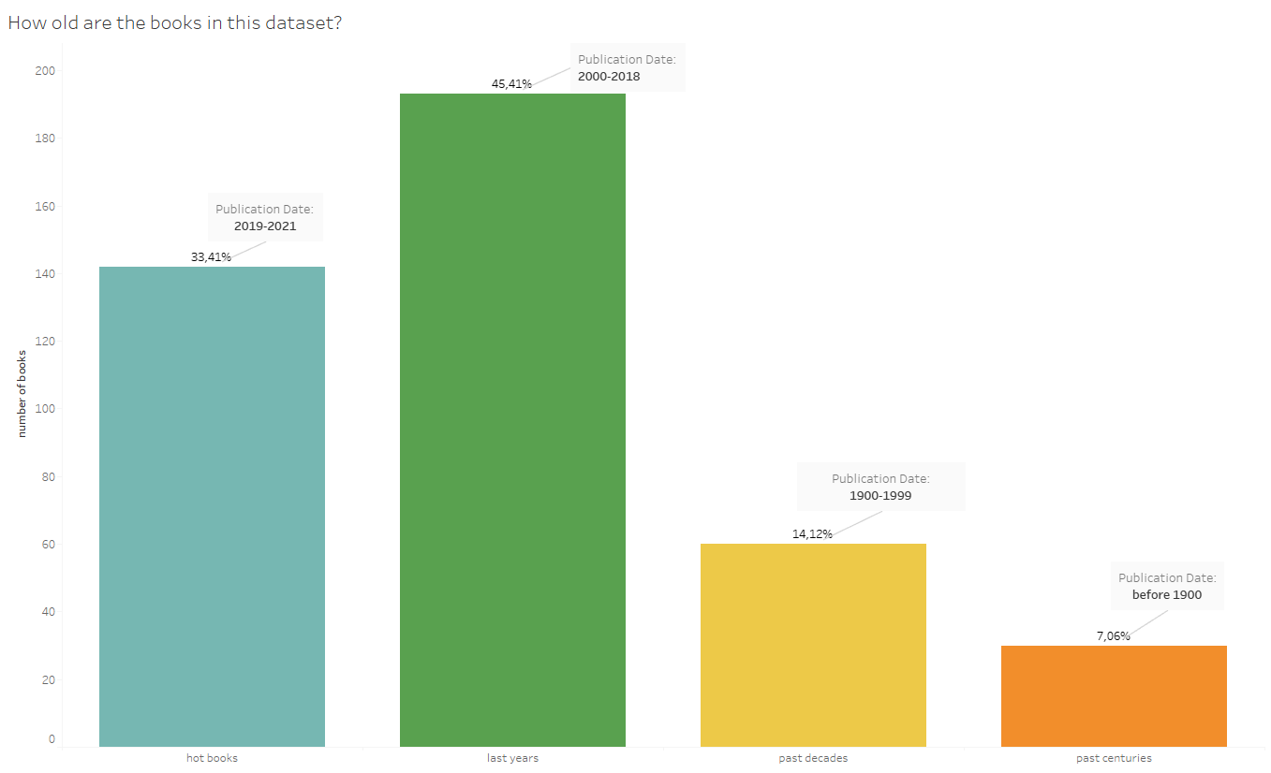
PUBLICATION DATE

Slide 21
PUBLICATION DATE

Slide 22
WORD FREQUENCY BY GENRE

Slide 23
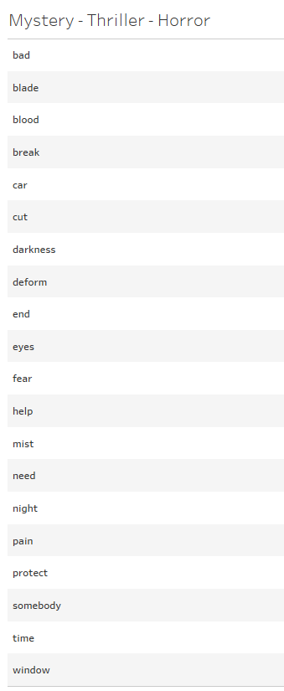
WORD FREQUENCY BY GENRE

Slide 24
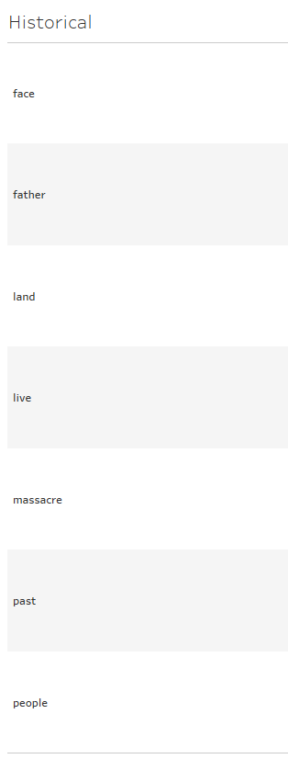
WORD FREQUENCY BY GENRE

Slide 25
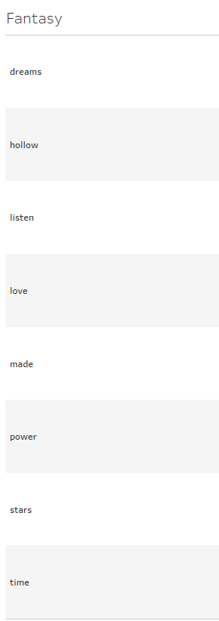
WORD FREQUENCY BY GENRE

Slide 26
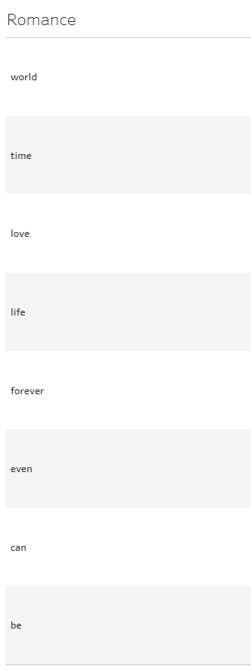
WORD FREQUENCY BY GENRE

Slide 27
RECOMMENDER

Slide 28
LIMITATIONS AND PROJECTION

Slide 29
LIMITATIONS AND PROJECTION
Own data collection
Small dataset
Cleaning data
Time
Complexity data-model

Slide 30
LIMITATIONS AND PROJECTION
Own data collection
Small dataset
Cleaning data
Time
Complexity data-model
Future?
Improve the project?

Slide 31
THANKS!

